Slide 1

NBA Player Data ETL Project
2019-2020 NBA Season Statistics, NBA 2K Rating,
and FiveThirtyEight’s: NBA WAR Rating

Slide 2


Extract, Transform, and Load
Extract NBA player data from 3 sources
Transform data to one final dataframe
Load final dataframe to PostgreSQL database

Slide 3

Extract data
2019-2020 NBA season statistics
https://www.basketball-reference.com/
FiveThirtyEight’s The Best NBA Players This Season, According to RAPTOR
https://projects.fivethirtyeight.com/2020-nba-player-ratings/
NBA2K20 All Player Ratings
https://nba2kw.com/list/nba-2k20-all-player-ratings/

Slide 4

Transform data
Select / rename columns in Python Pandas
Drop unnecessary columns from all 3 sources
Merge all 3 dataframes
Correctly rename “Player” name to merge 3 sources on
Calculate percentages for the following
Free Throw, Field Goal, 3-point
Format / round percentages using .map & .format in Python on previous calculations and ratings columns
Round to two decimal places and add percentage signs

Slide 5
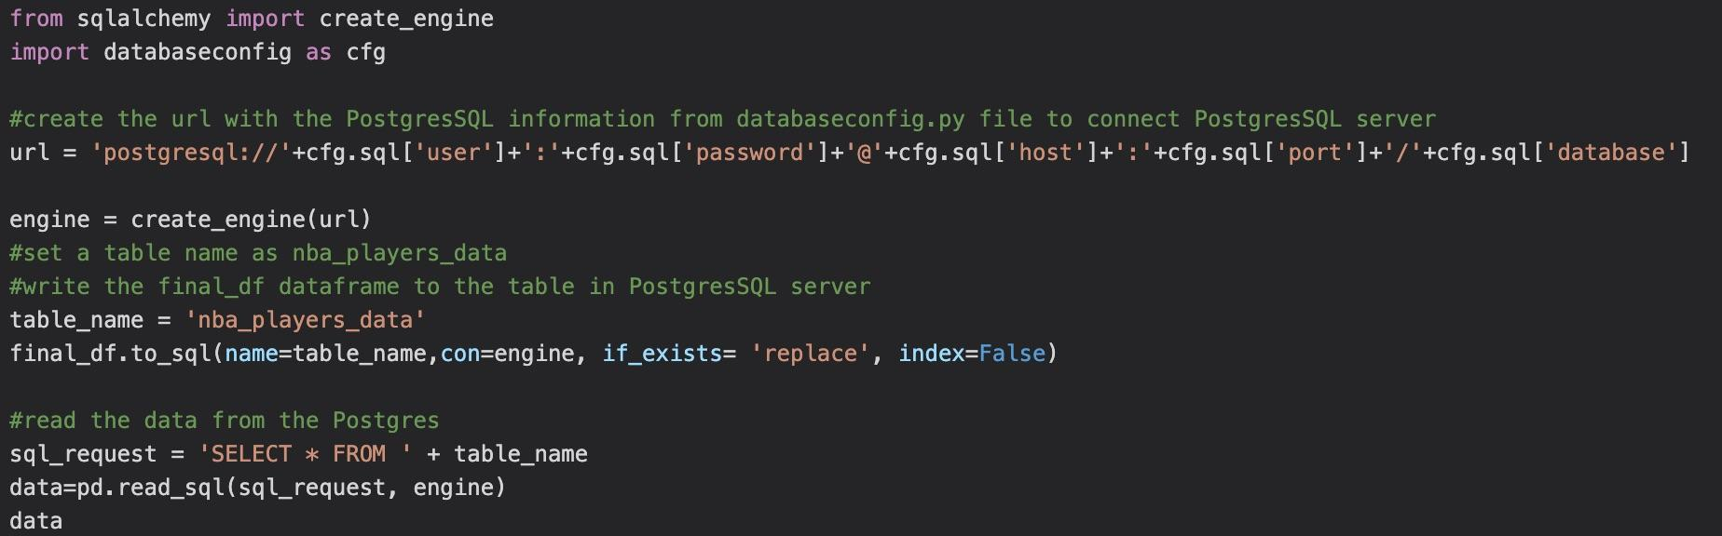
Load data
Create a new database in PostgreSQL called “NBA_player_db”
Connected to engine using SQLAlchemy: create engine import
Use .to_sql to load database into PostgreSQL database
Load final dataframe into PostgreSQL database

